Slide 1
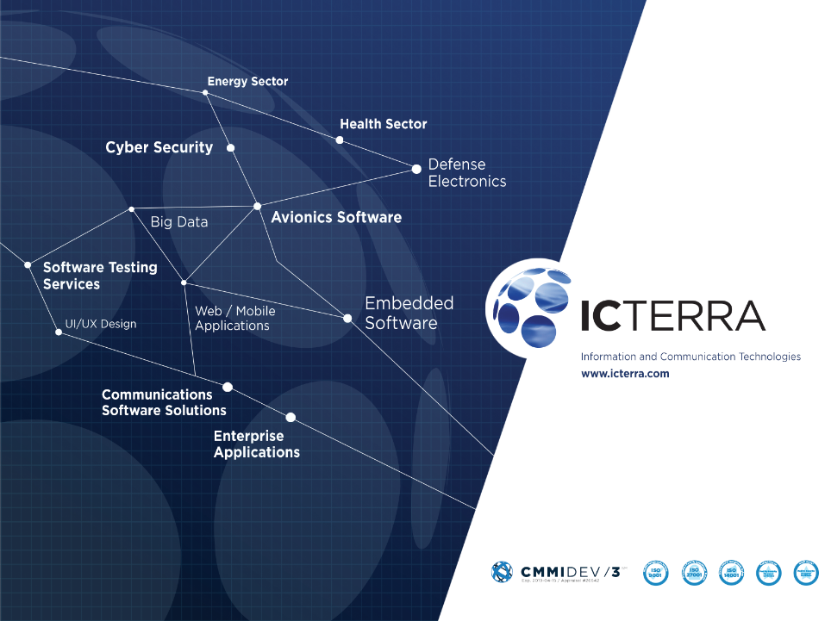

Docker at a Glance
&
Architectural Review of
a Supervisory Control and
Data Acquisition System
Serdar Mumcu
Project Manager
serdar.mumcu@icterra.com
Nurettin Mert Aydın
Group Manager (Energy Software)
mert.aydin@icterra.com
May 09, 2019

Slide 2

Outline – Docker at a Glance
Cloud Problems Overview
What is Container?
What is Docker?
Docker Benefits
Docker Terminology
Docker Installation
Docker CLI Usage
Dockerfile
Docker Compose
Docker Machine
Docker Swarm

Slide 3
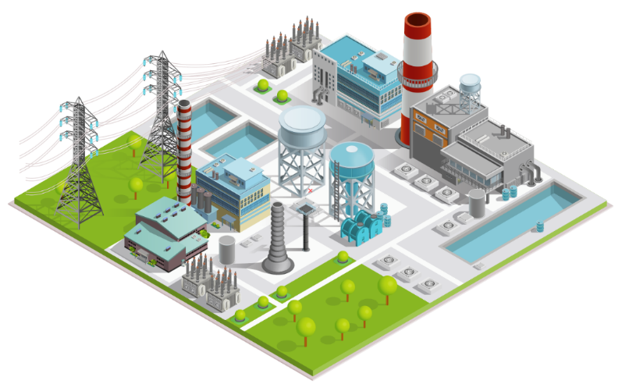
Outline – Architectural Review of a Supervisory Control and Data Acquisition System
ICterra – Energy & Utilities Expertise
Supervisory Control and Data Acquisition (SCADA) & Energy Monitoring System
- Technology Stack
- Microservices Architecture
- Container Orchestration with Kubernetes

Slide 4

Cloud Problems Overview
Performance
Algorithms
Disk I/O
Architecture
Tools (Redis, NoSQL, Elasticsearch)
Bandwidth Utilization
DB Connection Pooling
Bundle / minify / mundle
SSL validation
Caching
Gzip
CDN Usage
Single Page Application
Scaling
Stateless
Message Queuing
Lightweight Mechanisms
Auto-scaling

Slide 5
Cloud Problems Overview
Security
DOS / DDOS
SQL Injection
Monitoring
Real-time monitoring
Usability
UI/UX
Deployment
CI / CDelivery
CDeployment (zero-downtime deployments)
Blue-Green deployment
Testing
Unit Tests
Automated Tests
Performance Tests
Load Tests
Stress Tests
Risk Management
Hardware failures
High Availability
Costs Minimization (Especially Cloud Providers)
- Hardware Utilization
Portability
- Migration to another cloud providers easily

Slide 6
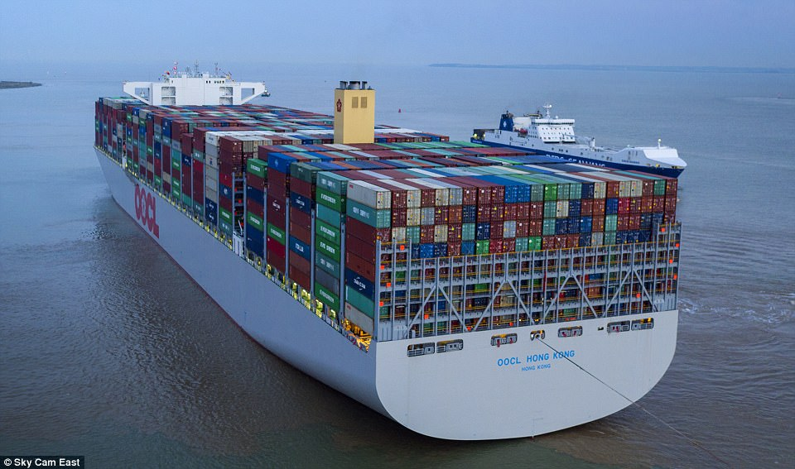
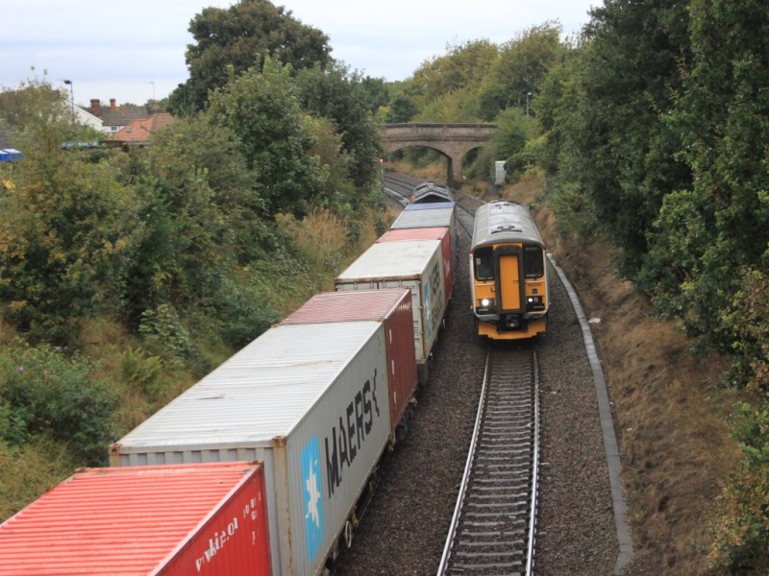
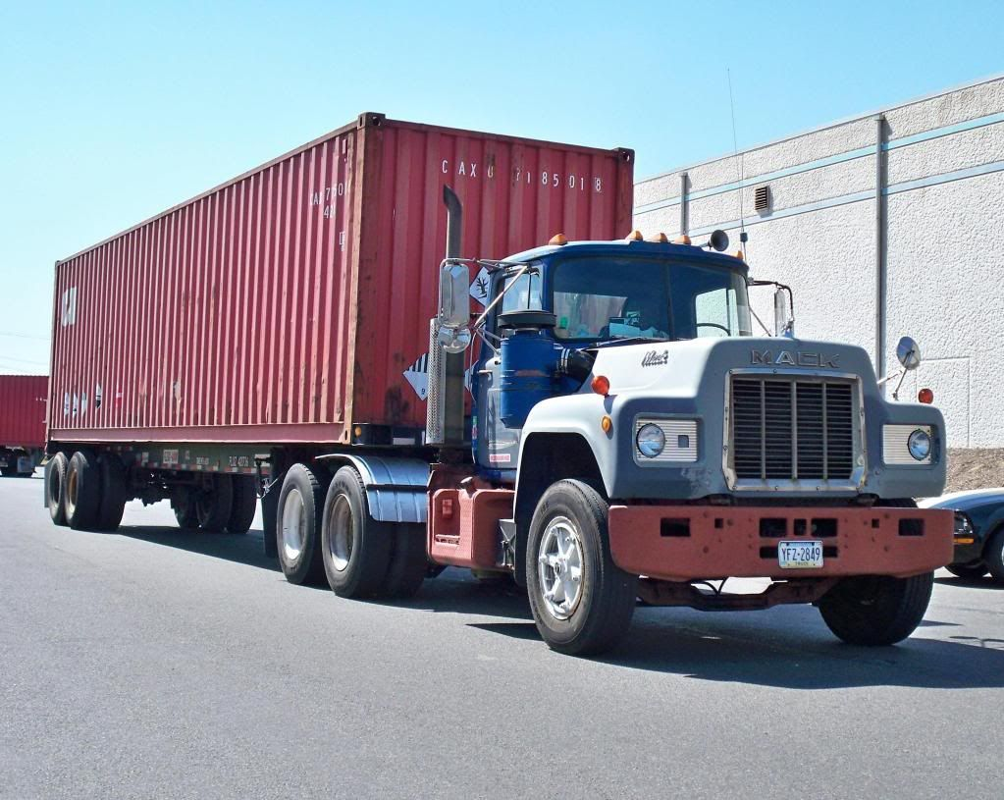
What is a Container?

Slide 7
What is Docker?
Solomon Hykes
Since 2013
Docker Inc.
Written in Go
Moves very fast

Slide 8
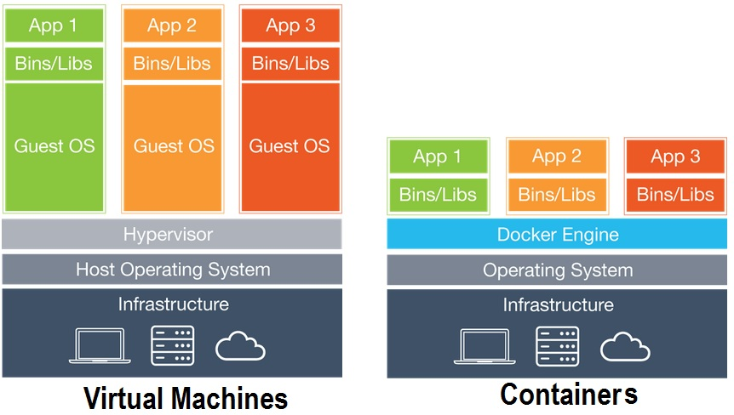
VMs vs. Containers

Slide 9
Benefits of Docker
Dev-Prod Parity
Easy Developer Onboarding
Infrastructure Utilization
Fast and Easy Deployments
Microservices Support
Support for Cont. Int/Del.
Learning new technologies
Portability

Slide 10
Docker Terminology
Docker Image
Docker Container
Docker Volume
Docker Registry
Docker CLI
Docker Daemon (Engine)

Slide 11
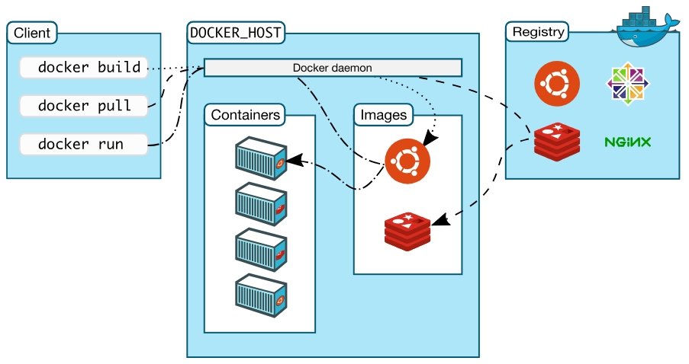
Docker Architecture

Slide 12
Docker Installation
Linux (Natively supported)
Windows 10 Pro/Ent (Hyper-V)
Mac OS (HyperKit)
Windows 7/8/8.1 or Older Mac Versions – Docker Toolbox

Slide 13
Docker CLI
docker version / docker info
docker / docker --help
docker container run --rm
docker image ls
docker volume ls
docker ps

Slide 14
Docker CLI
docker container run -p 8080:80 nginx:v1.14

Slide 15
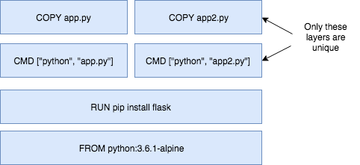
Dockerfile
Image: App binaries and dependencies (No kernel, no kernel modules)
Image layers
docker history nginx:latest

Slide 16
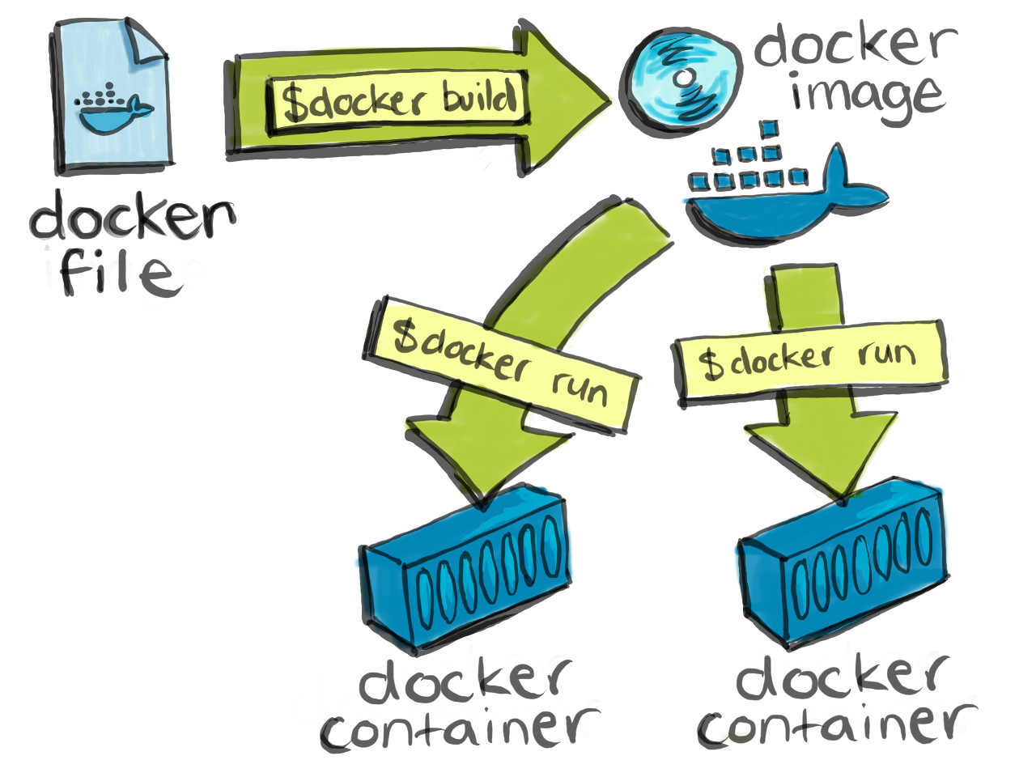
Dockerfile
Dockerfile
FROM
ENV
RUN
COPY
EXPOSE
CMD

Slide 17
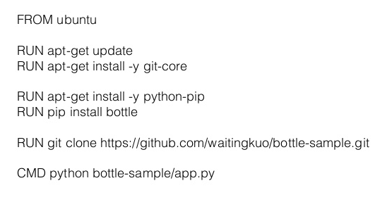
Dockerfile
docker image build –t serdarmumcu/customnginx .

Slide 18
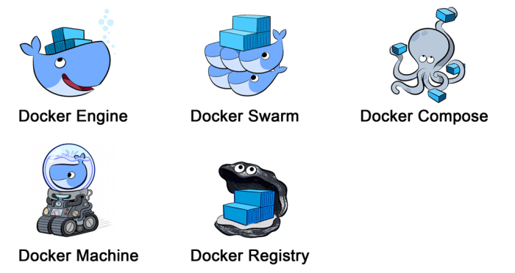
Other Docker Tools

Slide 19
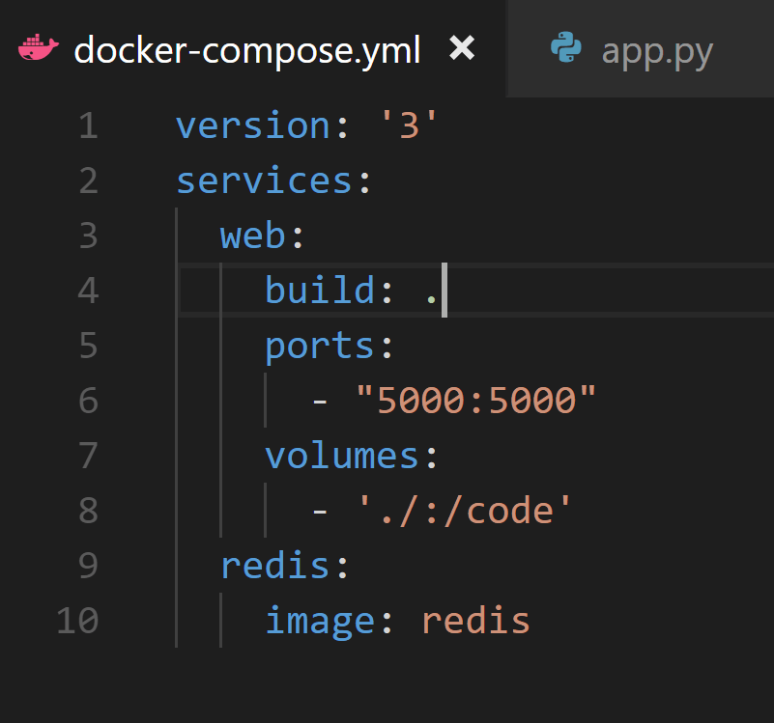
Docker Compose
docker-compose up/down

Slide 20
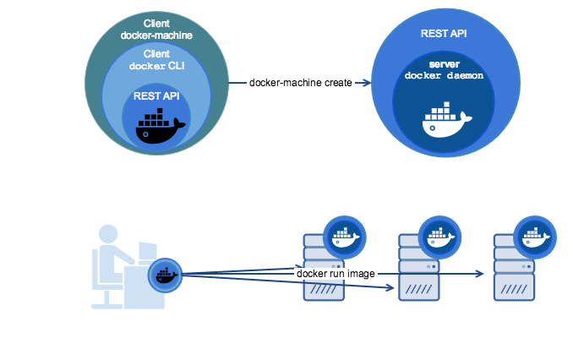
Docker Machine
docker-machine create --driver digitalocean --digitalocean-access-token $DIGITALOCEAN_ACCESS_TOKEN --digitalocean-ssh-key-fingerprint $DIGITALOCEAN_SSH_KEY_FINGERPRINT --digitalocean-image $DIGITALOCEAN_IMAGE --digitalocean-region $DIGITALOCEAN_REGION

Slide 21
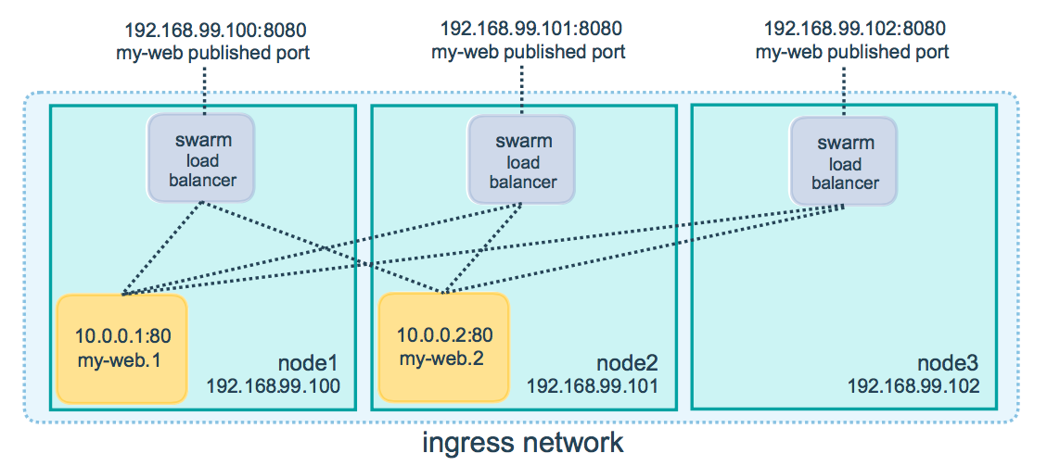
Docker Swarm
Healthcheck / Auto-restart
Autoscaling /Desired State Reconciliation

Slide 22
ICterra Energy & Utilities Expertise
High Available Infrastructure
Microservices
Containerization (Docker)
Orchestrated Flows
(Docker Swarm, Kubernetes)
Georedundancy with advanced disaster recovery scenarios
Mission–Critical Software Development
Model-driven Development
Embedded Software Development
MISRA C Compliant Coding
Reusable Software Units Applicable to Different Domains (Electricity, Natural Gas, Water, etc.)
Cutting-Edge
Infrastructure
Reliable & Portable Development
Security
Protocol Level Security
Edge Device Security
Granular Role-Based
User Access
Management
Security
Fast Access to Labelled Data
Centralized Data Farm
Time-Series Analysis
Predictive Analysis & Analytics
Machine Learning
Customized Trends
SMART, SCALABLE AND RELIABLE SOLUTIONS FOR
ENERGY & UTILITIES
Big Data & Analytics
Real-Time Visibility
Full Event Stack
Asset Management
Event Diaries
Audit Trails
Alarm Management
Supported Protocols
IEC 60870-5-104
IEC 61850
Modbus
DNP3
Straton
Real-Time Visibility
Communication Protocols

Slide 23

Supervisory Control and Data Acquisition (SCADA) & Energy Monitoring System
Reception of measurement data with IEC 60870-5-104, Modbus, DNP3 protocols and Straton REST services and conversion to common data model (IEC-61870/IEC-61950) for processing
Microservices on top of Docker containers with state of the art technologies
Orchestration of infrastructure services with Kubernetes
Publish / subscribe architecture with AMQP protocol
Big data infrastructure for sensor data storage and analysis using Apache Storm and Elasticsearch
Real-time displaying of measurement data on a dashboard with intuitive controls for the best user experience
Gathering time-tagged historical data for analytics and in-depth observation
Data processing for real-time alarm generation and distribution
Real-time map-based alerts
Distributed resource definition (topology) using connectivity,
hierarchy and geographic locations
Over 6 million measurements collected and stored in time series
databases, processed and presented to control center operators
Instant reports
Customizable dashboards and widgets
Data analytics

Slide 24
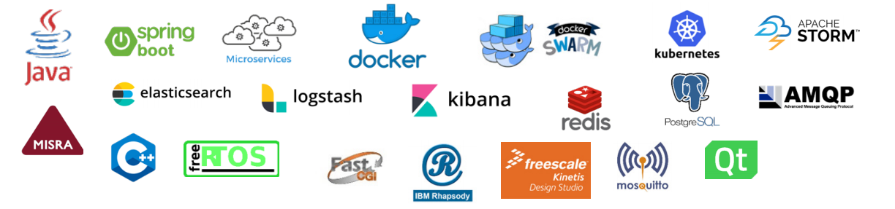
Technology Stack

Slide 25
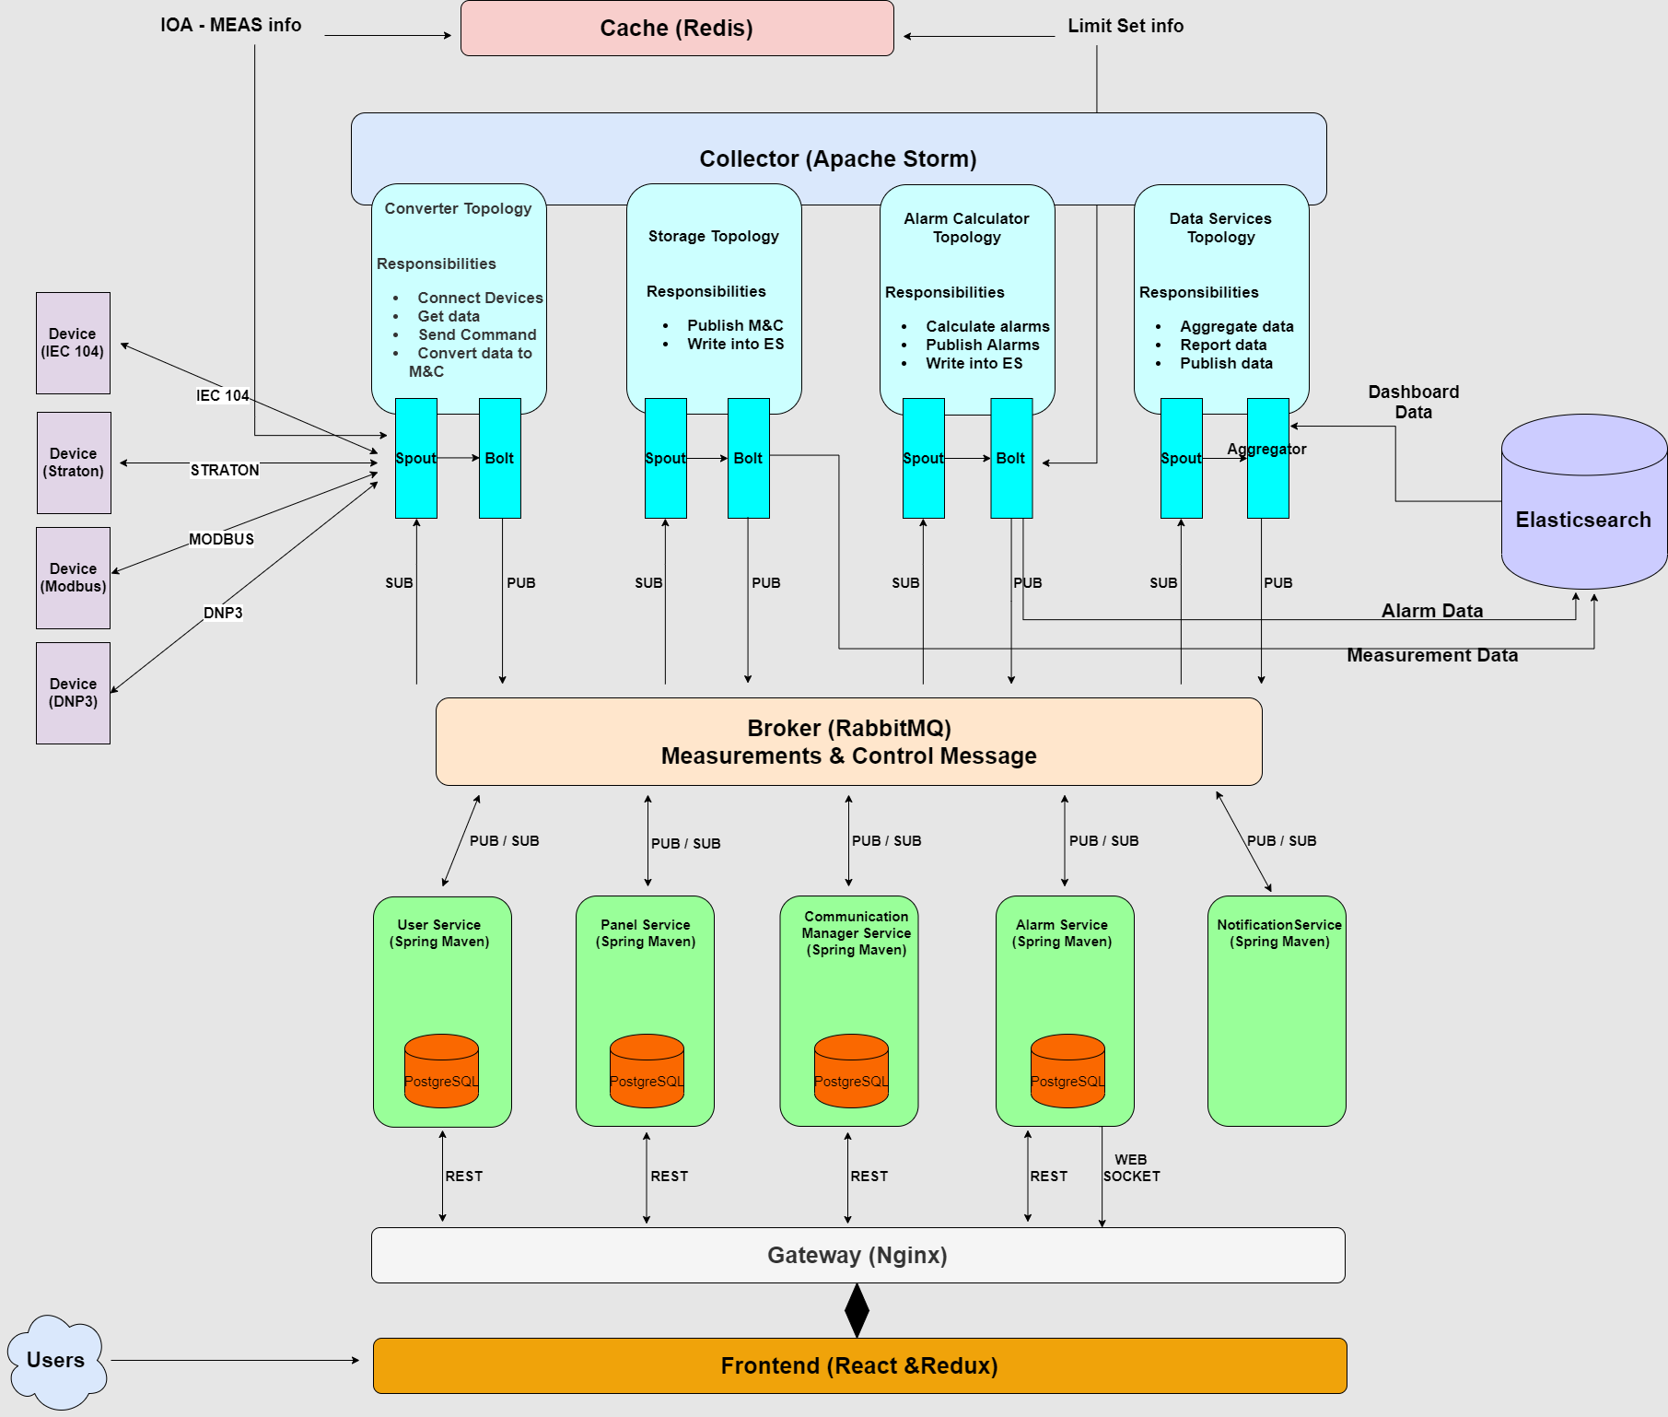
Microservices Architecture

Slide 26
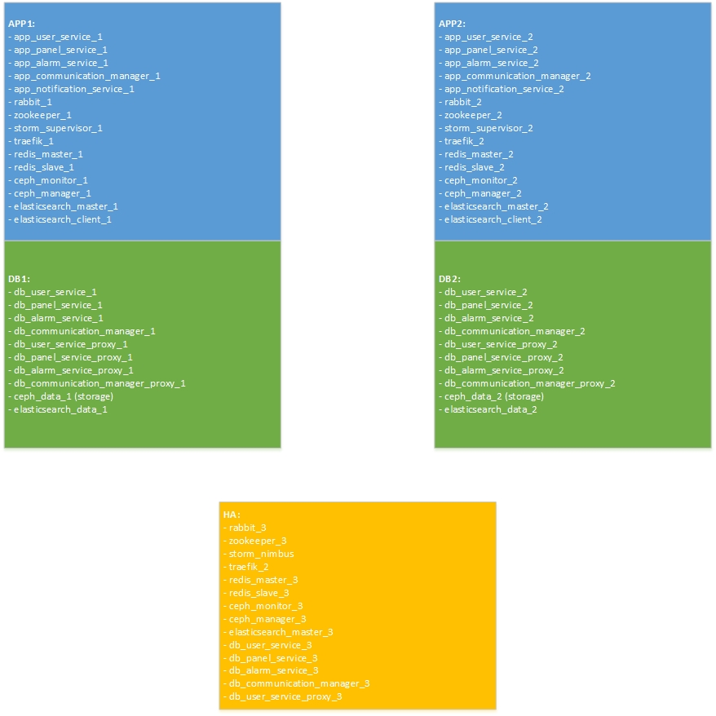
Container Orchestration with Kubernetes

Slide 27
Thank you

